Slide 1

Navigating Stroke Predictions: Unveiling Insights for Better Health Outcomes
Chelsea Berry
Data Science Capstones Project
June 2024

Slide 2
Understanding the Challenge
Strokes are a leading cause of disability and death worldwide.
Early prediction is crucial for effective prevention and treatment.
Current prediction methods can miss at-risk individuals.
Notes:
Strokes are one of the leading causes of disability and death worldwide, surpassing many other serious health conditions. The key to combating this issue lies in early prediction, which is crucial for effective prevention and treatment. However, current prediction methods often fall short, missing many individuals who are at risk. Our project aims to address these gaps by developing more accurate predictive models to identify those at high risk for strokes, allowing for timely and targeted interventions.

Slide 3
Project Aim
Accurately forecast patients with high stroke susceptibility and develop predictive models using biometric data and other factors to enhance stroke prevention and early intervention strategies.
Notes:
Our project aims to accurately forecast patients with high stroke susceptibility by developing predictive models that leverage biometric data and other relevant factors. The goal is to enhance stroke prevention and early intervention strategies, allowing healthcare providers to implement timely and targeted measures. By improving our ability to predict who is at risk, we can significantly reduce the incidence and impact of strokes.

Slide 4
Objective
Develop predictive models
Analyze and preprocess the dataset
Validate the predictive models
Integrate the predictive models
Conduct ongoing research
Notes:
To achieve our project aim, we have outlined several key objectives:
First, we will develop predictive models that utilize a range of biometric and demographic data to identify individuals at high risk of stroke.
Next, we will analyze and preprocess the dataset to ensure data quality and consistency, which is crucial for building accurate models.
Once the models are developed, we will validate the predictive models to ensure they perform well across diverse populations and scenarios.
We will then integrate these predictive models into clinical practice, leveraging electronic health record systems for real-time risk assessment and intervention.
Finally, we will conduct ongoing research to refine and enhance our models, incorporating new data and advanced techniques to improve stroke prediction further.
These objectives will guide our efforts to make a significant impact on stroke prevention and patient outcomes."

Slide 5
Audience and Impact
Clinical/Hospitals
Insurance Companies
Biotech Companies
Notes:
Our predictive models have broad applicability across various sectors:
Clinical/Hospitals:
By integrating predictive models into electronic health records (EHR), clinicians can identify high-risk patients early. This enables targeted interventions and personalized care plans, ultimately improving patient outcomes.
Insurance Companies:
These models can be used for risk assessment to set accurate premium pricing. Developing preventative health programs based on these models can help mitigate costs associated with stroke-related claims and promote healthier lifestyles among policyholders.
Biotech Companies:
Incorporating our predictive models into health monitoring devices allows for real-time risk assessments. This facilitates timely lifestyle adjustments and medical consultations, enhancing user engagement and supporting preventive healthcare.
In conclusion, the broad applicability of stroke prediction models has the potential to significantly improve healthcare delivery, reduce costs, and foster innovation across various industries.

Slide 6
Dataset Description and Data Preprocessing
Dataset Description
Total Records: 43,400 individuals
Diversity: Biometric, demographic, and lifestyle factors for detailed analysis and feature engineering
Data Preprocessing
Handling Missing Values
Encoding Categorical Variables
Normalizing Continuous Variables
Data Splitting
Notes:
Our dataset consists of health and demographic information for 43,400 individuals. This rich and diverse dataset includes biometric, demographic, and lifestyle factors, making it ideal for detailed analysis and feature engineering. The variety of data points allows us to build comprehensive predictive models to assess stroke risk accurately.
To ensure the highest quality and consistency of our data, we performed several key preprocessing steps:
Handling Missing Values: We imputed missing BMI values with the median and adjusted the smoking status with original dataset ratios.
Encoding Categorical Variables: We converted categorical variables into dummy variables to facilitate their use in the model.
Normalizing Continuous Variables: We standardized age, average glucose level, and BMI to ensure consistent scaling across features.
Data Splitting: Finally, we divided the dataset into training and testing sets using an 80-20 split to evaluate the model's performance effectively.
These preprocessing steps are crucial for developing robust predictive models for stroke risk assessment.

Slide 7
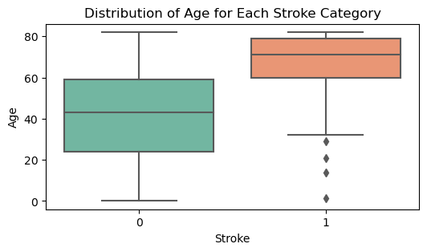
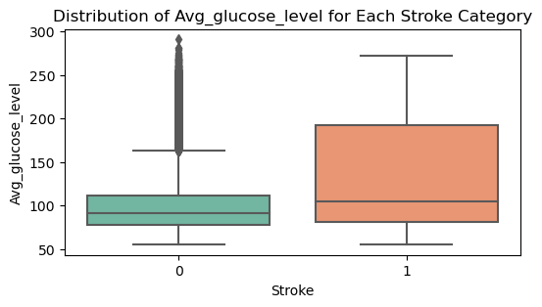
Exploratory Data Analysis
Key Insights
Age and Stroke: Stroke patients are generally older.
Average Glucose Level and Stroke: Stroke patients have higher average glucose levels.
Notes:
The EDA revealed significant correlations between age, average glucose levels, and stroke occurrence. These key findings emphasize the importance of these factors in predicting stroke risk. Understanding that older age and higher glucose levels are major risk factors can help in developing targeted interventions and preventive measures. By focusing on these critical variables, healthcare providers can enhance early identification and management of high-risk individuals, ultimately aiding in the prevention of strokes and improving patient outcomes.

Slide 8
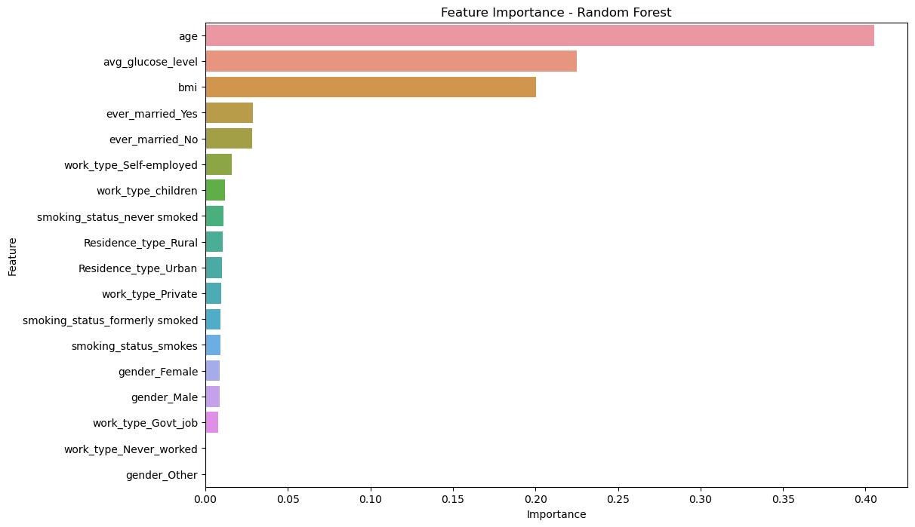
Feature Importance
Model Used: Random Forest with Grid Search Performance: Achieved high accuracy in predicting high-risk stroke individuals.
Key Predictors: Age, average glucose level, and BMI.
Notes:
Our predictive model utilized a Random Forest algorithm with Grid Search for hyperparameter tuning, achieving high accuracy in identifying individuals at high risk of stroke. The key predictors identified were age, average glucose level, and BMI. These factors align with known risk factors for stroke, demonstrating the model's reliability and its potential for practical application in clinical settings

Slide 9
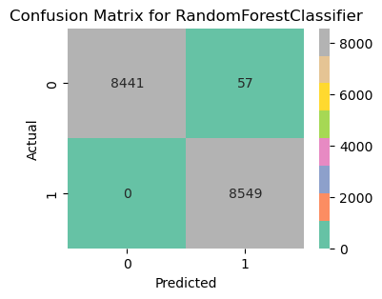
Model Performance
Stroke Cases ("Yes"):
Precision: 0.9934
Recall: 1.00 (no false negatives)
Non-Stroke Cases ("No"):
Precision: 1.00
Recall: 0.9933 (very low false positive rate)
Notes:
These results are particularly significant for stroke prediction because they demonstrate the model's ability to accurately and consistently identify individuals at high risk of stroke. The high precision and recall scores ensure that the model minimizes both false positives and false negatives, which is crucial in a clinical setting where accurate identification can lead to timely and potentially life-saving interventions.
Overall, the model's exceptional performance metrics indicate its potential for practical application in healthcare settings, providing a reliable tool for early identification and preventive care of individuals at high risk of stroke.

Slide 10
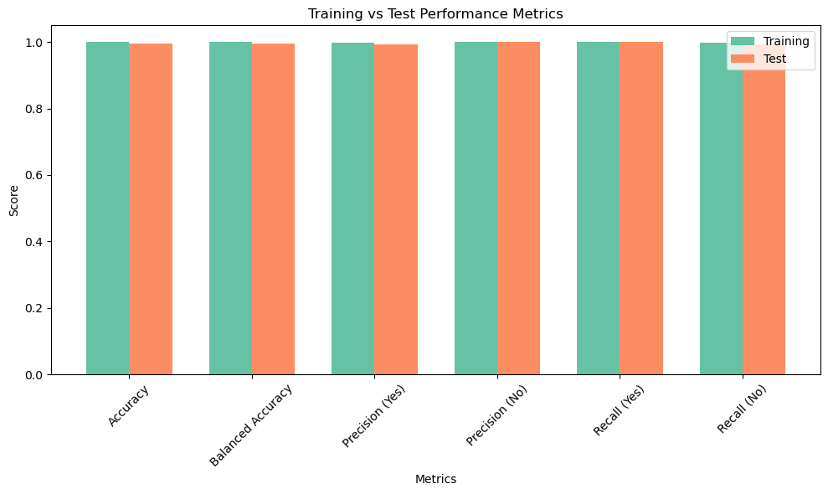
Training vs. Test Performance
Notes:
This chart compares the performance metrics of our Random Forest model on both training and test datasets. As we can see, the model achieves near-perfect scores across all metrics, including accuracy, balanced accuracy, precision for both stroke (Yes) and non-stroke (No) cases, as well as recall for both categories. By maintaining high performance on both training and test datasets, the model ensures consistent and accurate predictions, which are critical for practical applications in healthcare.

Slide 11
Factors Influencing Stroke Based on Model Performance
Key predictors identified include:
Age: Older individuals are significantly more at risk of experiencing a stroke, as reflected by the strong correlation and feature importance analysis.
Average Glucose Level: Elevated glucose levels are a prominent risk factor, aligning with known medical knowledge that associates high glucose levels with increased stroke risk.
BMI: Higher BMI is also a significant predictor, indicating that body weight and related health conditions contribute to stroke susceptibility.

Slide 12

Implications
Clinical Application:
Age, glucose levels, and BMI should be closely monitored in at-risk populations to facilitate early detection and preventive care.
Preventive Measures:
Targeted interventions focusing on managing glucose levels and maintaining a healthy BMI could significantly reduce stroke incidence.
Notes:
Based on our model's findings, we have two key areas of focus:
Clinical Application:
Age, glucose levels, and BMI should be closely monitored in at-risk populations.
This will facilitate early detection and preventive care, allowing healthcare providers to intervene before a stroke occurs.
Preventive Measures:
Targeted interventions focusing on managing glucose levels and maintaining a healthy BMI could significantly reduce stroke incidence.
By implementing these measures, we can help at-risk individuals adopt healthier lifestyles and reduce their stroke risk.
These recommendations highlight the practical applications of our model in clinical settings and the importance of proactive health management.

Slide 13
Enhancing Stroke Prediction
Expand Datasets
Advanced Modeling Techniques
Integrate Real-Time Data
Clinical Validation
Notes:
Enhancing Stroke Prediction
Expand Datasets:
Incorporate larger and more diverse datasets.
Improve model generalizability and accuracy across different populations.
Advanced Modeling Techniques:
Explore ensemble learning and neural networks.
Refine predictive capabilities.
Integrate Real-Time Data:
Use data from wearable health devices.
Enable continuous monitoring and early intervention.
Clinical Validation:
Collaborate with healthcare professionals.
Validate and fine-tune models in clinical settings.
Ensure predictive tools are accurate and actionable in real-world applications.

Slide 14
Conclusion
Key Findings:
Age and average glucose levels are critical predictors of stroke.
Older individuals and those with higher glucose levels are at markedly increased risk.
The Random Forest model achieved near-perfect accuracy, precision, and recall.
Model Performance:
Exceptional performance on both training and test datasets.
Reliable and potential for practical application in clinical settings.
Notes:
In conclusion, our study highlights the critical factors influencing stroke risk, including age, glucose levels, and BMI. By developing a highly accurate predictive model, we provide valuable insights that can be leveraged for early detection and prevention of strokes. Implementing these findings into clinical practice and preventive measures will not only improve patient outcomes but also reduce the overall incidence and burden of strokes on healthcare systems. Our work highlights the importance of data-driven approaches in enhancing public health strategies and optimizing resource allocation.

Slide 15
Acknowledgement
Special thanks to Shmuel Naaman for mentoring and advising during this project
SpringBoard Data Science Program

